Slide 1
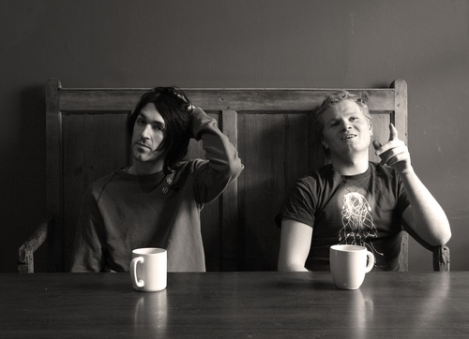
Duologues & sCENES
Drama
Year 9
Lesson 3 Semiotics

Slide 2

LESSON AIM
To know what SEMIOTICS means and understand how it can be used within Drama.

Slide 3

LESSON OUTCOME
LEVEL 4 – I will know what SEMIOTICS means.
LEVEL 5 – I will know what SEMIOTICS means and understand how it can be used within Drama.
LEVEL 6 – I will be able to use SEMIOTICS effectively within a Drama scene.

Slide 4
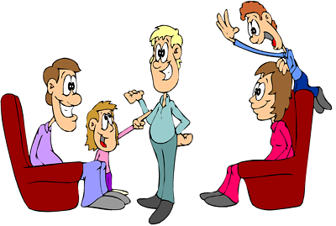
CHARADES
Students sit in a circle.
One student will go into the circle and do a mime to get the rest of the students to guess what they are miming.
Notes:
You may want to use a theme and have students write their ideas on a piece of paper that is then pulled from a hat.

Slide 5
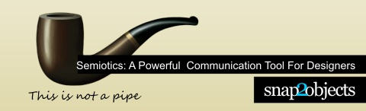
Semiotics: A Powerful Communication Tool For Designers
There is an important thing present in advertising and other design uses, that we call semiotics. Actually, it’s present in everything in our lives, so deep that we don’t always pay attention and it happens naturally. So, what is this thing that surrounds us and is so important for design and advertising? The semiotics is the study of signs, and through them, it studies the origins of meaning in different languages of communication.

Slide 6
It goes deep into communication languages, verbal or non-verbal, to even understand why we think about the image of a rose when we hear the word “rose”. Why is this sound or theses letters connected to this object? What is the relation between them that makes the meaning? And more, why do we think about passion when we think about the rose? Though? Just a little, but we’ll talk more about it and show how to use this knowledge for communication and persuasion.

Slide 7
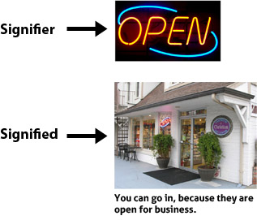
What do we need to know to make use of semiotics?
First, know what is a sign and its kinds. A sign is anything that makes meaning. Anything? Sure, if you see/hear something and understand that, it is a sign. They are the mediators to the world. According to Saussure, the signs have two aspects: signifier and signified. The first one is the material that has a meaning and the second one is the meaning. For example, the open sign is the signifier, while the signified is that you can go in.

Slide 8

STILL IMAGE SIGNS
In groups of 2, 3 or 4 make a still image of a sign that you may see in every day life.

Slide 9
The use of semiotics in our lives
Now let’s see the kind of signs according to Peirce and then analyse some things in our lives on which we can see the use of semiotics.
The three kinds are:
ICONS
INDEX
SYMBOLS

Slide 10

Icons – a clear representation of the object itself, keeping its characteristics. There’s no distinction between the icon and the real object. Examples are: photos, drawings, imitations, onomatopoeias and others.

Slide 11
STILL IMAGE
In groups of 2, 3 or 4 make a still image of what you consider an ICON to be.

Slide 12
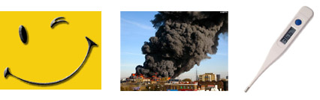
Index – They indicate something. The index connected with its meaning (not arbitrary) but unlike the icon, it’s not the object itself. As examples, we can say that smoke indicates fire, smiles indicate happiness, fresh coffee smell in the morning indicates that someone's preparing breakfast. Even medical symptoms and measuring instruments are indexes, because they indicate something.

Slide 13
STILL IMAGE
In groups of 2, 3 or 4 make a still image of what you consider an INDEX to be and make sure you can define what it may be indicating.

Slide 14

Symbols – They have no resemblance to the real object, it’s a result of a convention. A symbol can only make meaning if the person already knows that, so, this is a matter of culture and previous knowledge. We all know that a dove represents peace, but there’s no connection between the animal and peace, it’s just a convention. Letters and words are examples of symbols. The graph sign (words) has no direct link to the thing itself, but for each culture, they make meaning. For us, the mourning is represented by the color black, but this color changes for different countries and cultures.

Slide 15
STILL IMAGE
In groups of 2, 3 or 4 make a still image of what you consider a SYMBOL to be and make sure you can define what it may be symbolising.

Slide 16
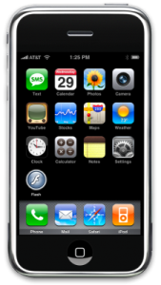
Let’s analyse a common object, some moble phone “icons”:
Here we can see some real icons (representation of the object itself) like the calendar, the camera and the clock. Also, some indexes (signs that have a connection with the object, but it’s not its real representation) like the stocks, You Tube or mail. If they were real icons, there should be a photo of a stock exchange, a thumbnail of a You Tube video and an electronic mail image. Finally, we see also a symbol, for Flash. There’s no visual connection from the Flash “icon” to the real meaning.
There’s no specific indication of what is that, but we know, because there’s a previous knowledge that Flash is an application for animations (ok, this image – flash – is not real, but useful for educational purposes). The designers who projected this screen were aware of the signs and its meanings, as we all shall be when designing anything. It is important because it’s the base for communication, which is the final purpose.

Slide 17
What have you achieve today? LESSON OUTCOME
LEVEL 4 – I will know what SEMIOTICS means.
LEVEL 5 – I will know what SEMIOTICS means and understand how it can be used within Drama.
LEVEL 6 – I will be able to use SEMIOTICS effectively within a Drama scene.

Slide 18
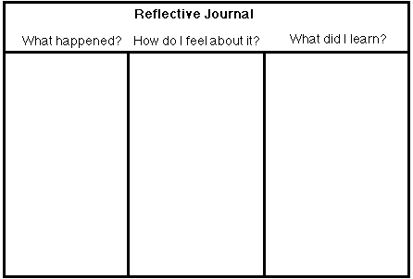
REFLECTIVE LOG
It is important to reflect on every lesson and begin thinking about setting targets for yourselves. For assessment it is important to keep a log book of activities, so you must write a reflective log for each lesson.

